Slide 1



MICROCONTROLLERS
TYPES AND APPLICATIONS
Code Sinaia 2025
2025 Copyright © by INPROTED– International Professionals for Technology and Education | All Rights Reserved

Slide 2

Curpins
Despre noi
Introducere in microcontrolere
Ce sunt microcontrolerele
Placi de dezvoltare
Utilizari zilnice & IoT
Placi entry-level : Arduino vs ESP platform
Live demo
Proiectele Noastre
Monitorizarea panourilor solare
Testarea prototipurilor a plăcilor din așchii de lemn
Q&A
2025 Copyright © by INPROTED– International Professionals for Technology and Education | All Rights Reserved

Slide 3
Despre noi
George
Absolvit liceul anul acesta
Locul 1 de 2 ori la ONTI
Backend developer
Ștefan
Absolvit liceul anul acesta
Pasionat de securitate cibernetica, muzica, sport, filozofie
Frontend developer
2025 Copyright © by INPROTED – International Professionals for Technology and Education | All Rights Reserved

Slide 4
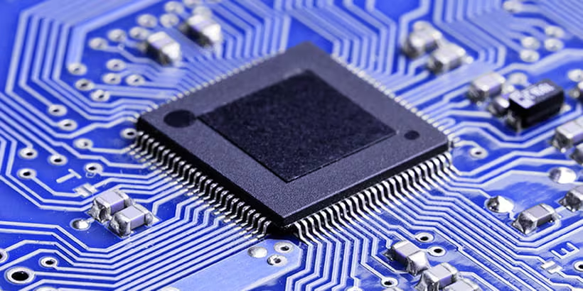
Ce sunt microcontrolerele?
Microcontrolerele sunt circuite integrate mici care conțin un procesor, memorie și dispozitive periferice, utilizate pentru a controla diverse dispozitive electronice.
2025 Copyright © by INPROTED – International Professionals for Technology and Education | All Rights Reserved

Slide 5
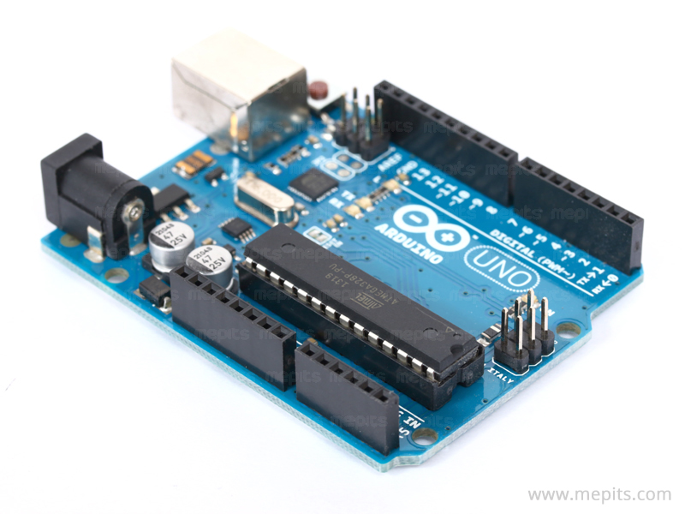
Plăci de dezvoltare
Plăcile de dezvoltare sunt platforme hardware care integrează un microcontroler și componente auxiliare, facilitând programarea și testarea rapidă a proiectelor electronice.
2025 Copyright © by INPROTED – International Professionals for Technology and Education | All Rights Reserved

Slide 6
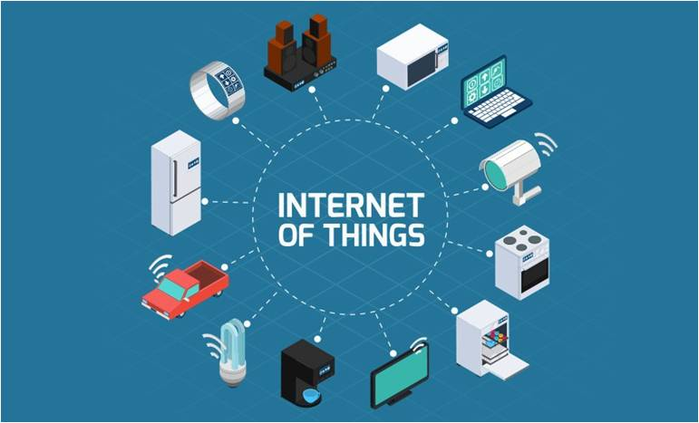
Utilizari zilnice & IoT
Microcontrolerele și plăcile de dezvoltare sunt folosite zilnic în:
1. Aplicații IoT (Internet of Things)
Smart Home (termostate, becuri inteligente, sisteme de securitate)
Wearables (ceasuri smart, trackere de fitness)
Agricultură inteligentă (senzori de umiditate, irigații automate)
Monitorizare industrială (senzori de temperatură, control motoare)
2025 Copyright © by INPROTED – International Professionals for Technology and Education | All Rights Reserved

Slide 7
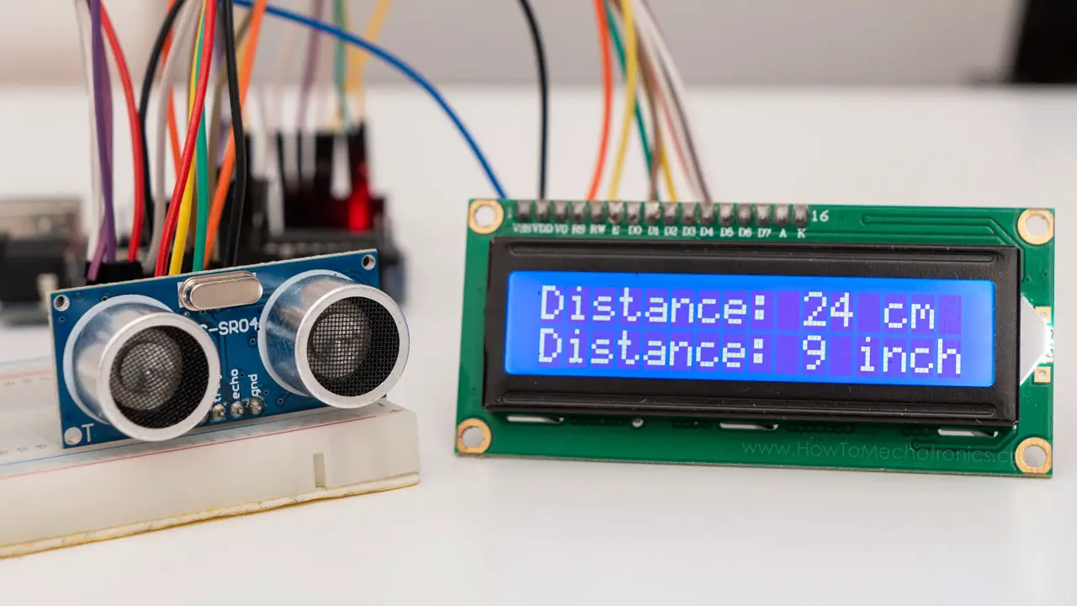
Utilizari zilnice & IoT
2. Dispozitive folosite in fiecare zi
Electrocasnice (frigidere, mașini de spălat, aer condiționat)
Automobile (sisteme de navigație, senzori de parcare)
Jucării și drone (control motoare, senzori de mișcare)
Automatizări (roboți, sisteme de deschidere uși)
2025 Copyright © by INPROTED – International Professionals for Technology and Education | All Rights Reserved

Slide 8
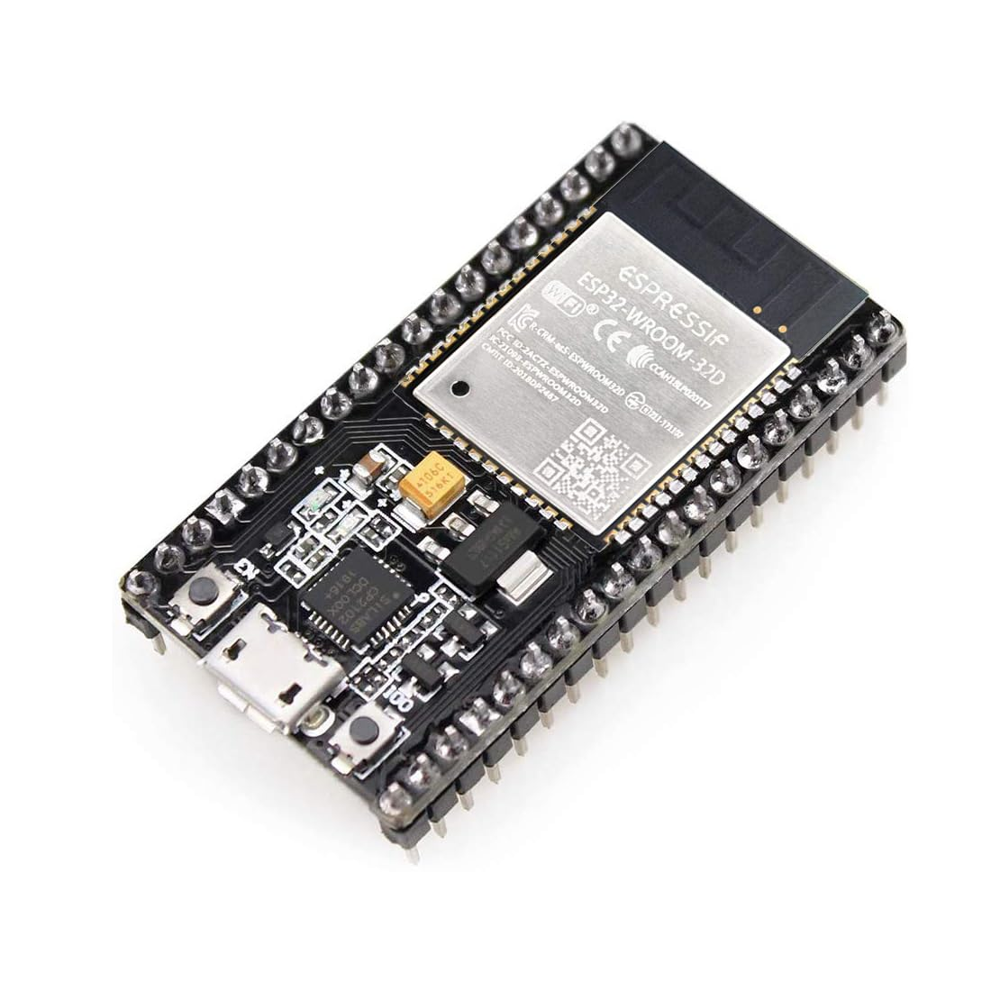
Utilizari zilnice & IoT
De ce sunt ideale pentru IoT?
Consum redus de energie
Conectivitate (Wi-Fi, Bluetooth, LoRa)
Procesare în timp real la cost mic
(Plăci populare pentru IoT: ESP32, Arduino IoT Cloud, Raspberry Pi, NodeMCU.)
2025 Copyright © by INPROTED – International Professionals for Technology and Education | All Rights Reserved

Slide 9
Plăci entry-level : Arduino vs ESP
Arduino
ESP
Memorie: 2-32 KB SRAM, 32 KB Flash
Procesor: 8 bit (16 MHz)
Wi-Fi/Bluethooth: Necesita shield extern
Pret: 20-30 lei
Capabilitati IoT: Limită (necesită module extra)
Memorie: 80-520 KB SRAM, 4-16 MB Flash
Procesor: 32 bit (80-240 MHz)
Wi-Fi/Bluethooth: Vine cu ele din fabrica
Pret: 20-50 lei
Capabilitati IoT: Excelent (Wi-Fi integrat, MQTT, HTTP)
2025 Copyright © by INPROTED – International Professionals for Technology and Education | All Rights Reserved

Slide 10
Live Demo
Arduino vs ESP
Arduino IDE vs ESP-IDF
2025 Copyright © by INPROTED – International Professionals for Technology and Education | All Rights Reserved

Slide 11
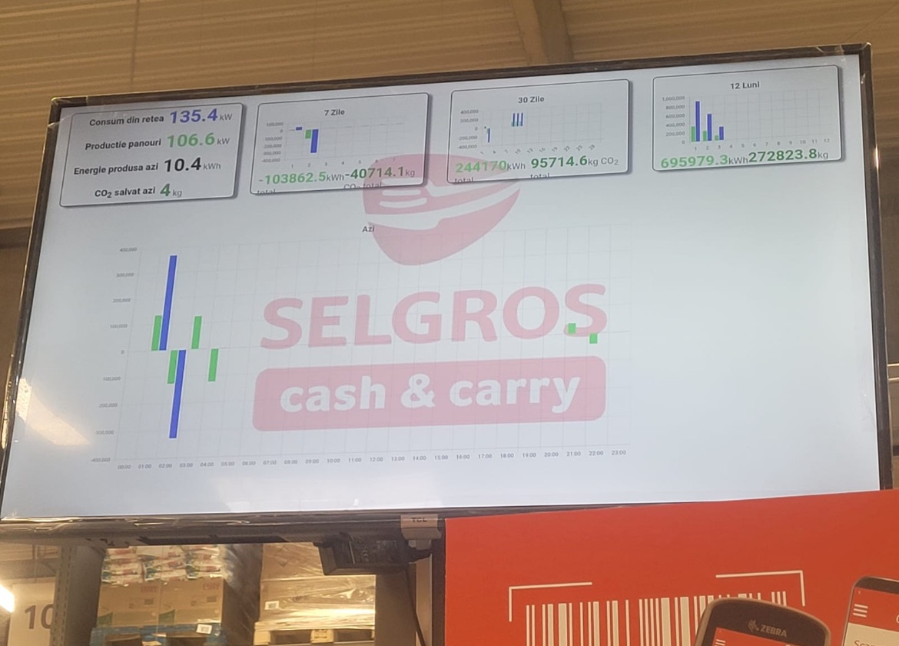
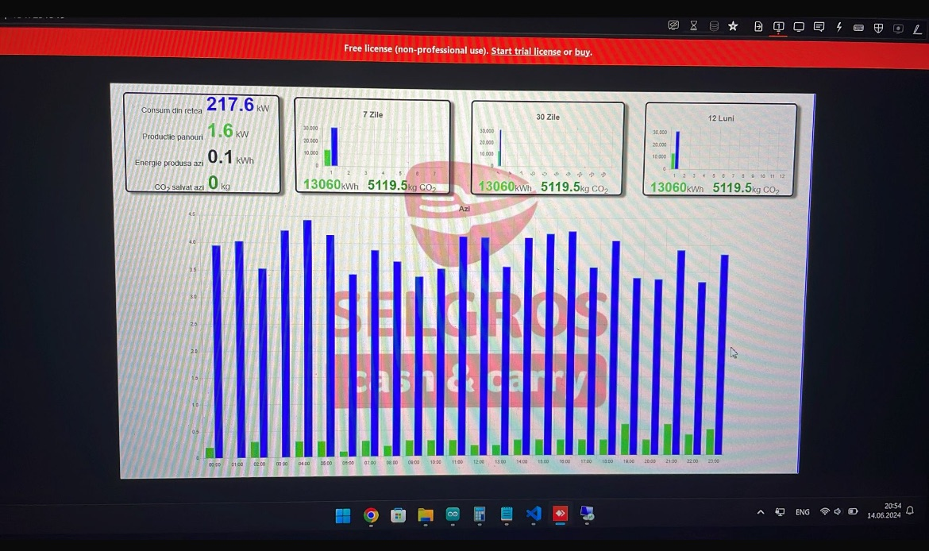
Proiectele Noastre
Monitorizarea Panourilor Solare
2025 Copyright © by INPROTED– International Professionals for Technology and Education | All Rights Reserved

Slide 12
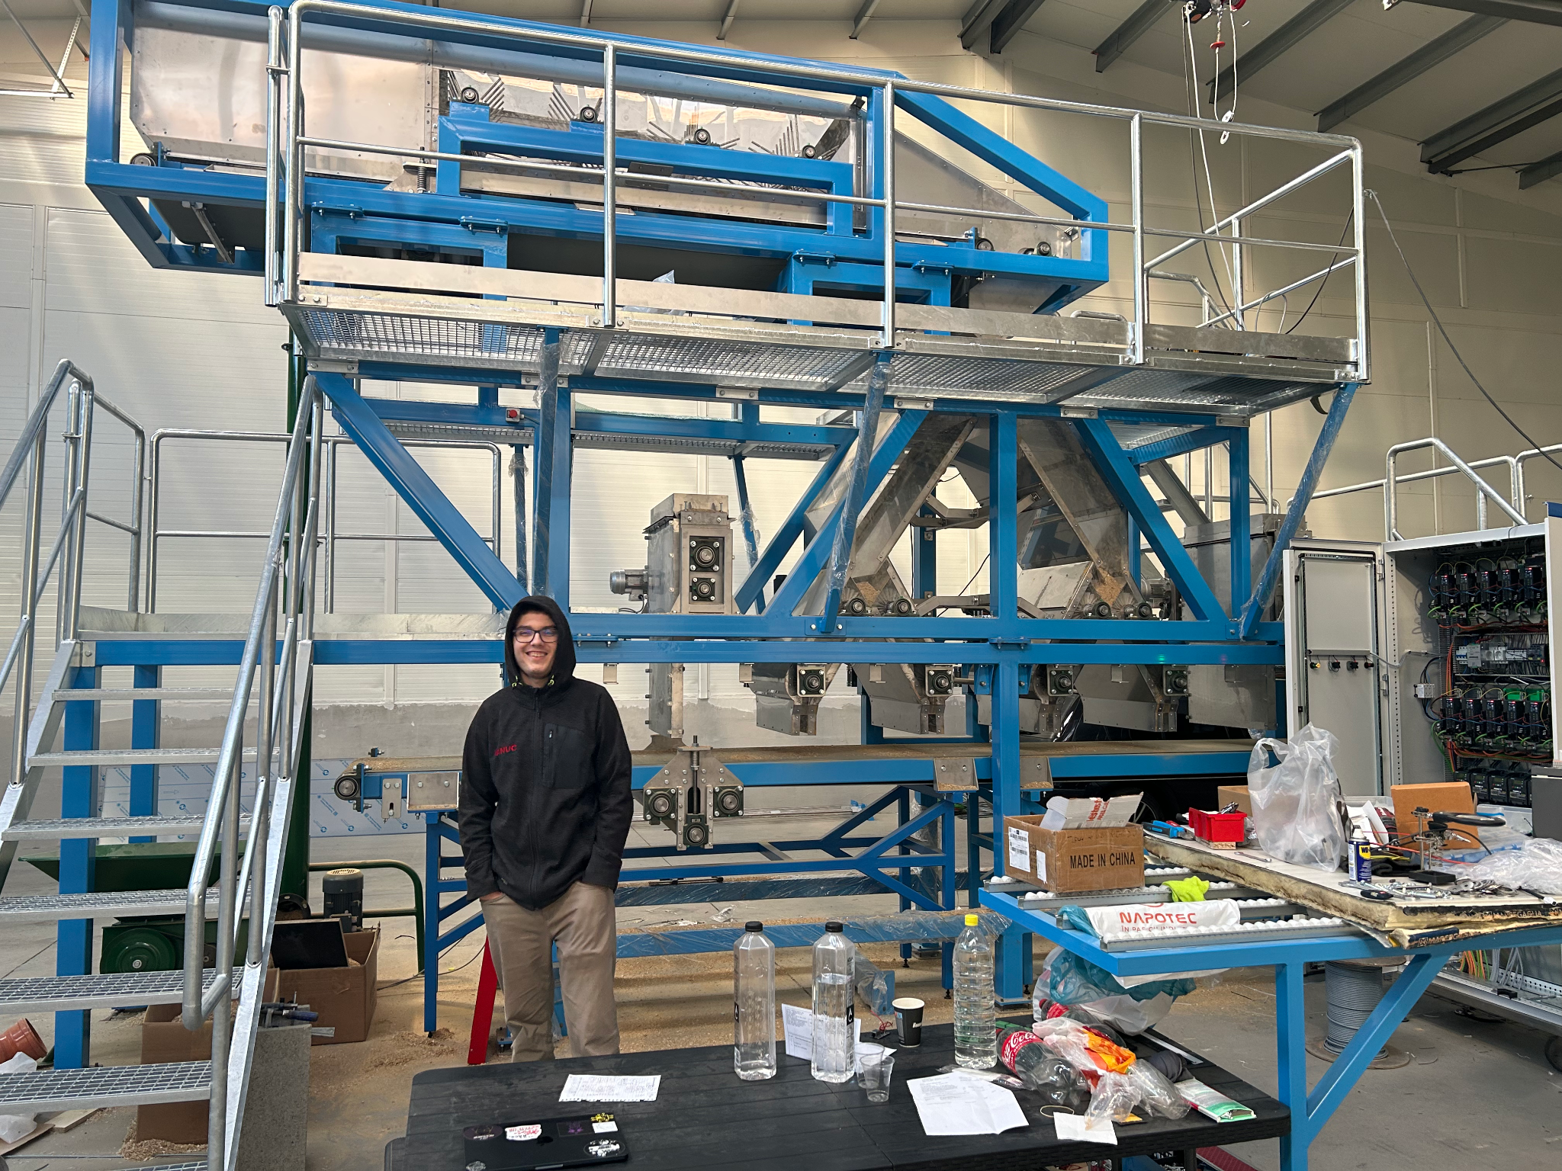
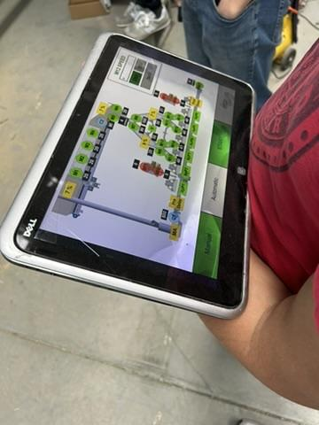
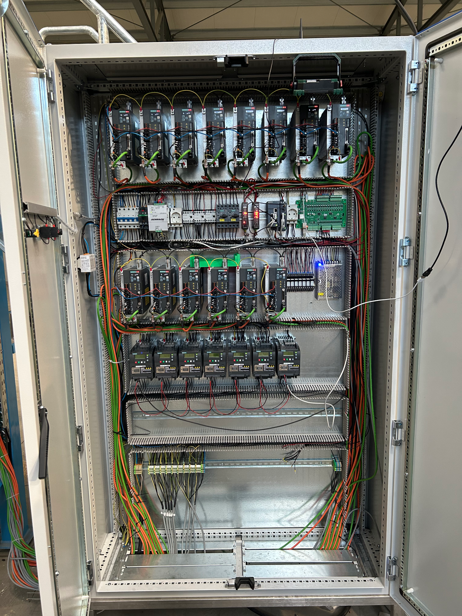
Proiectele Noastre
Testarea prototipurilor a plăcilor din așchii de lemn
2025 Copyright © by INPROTED– International Professionals for Technology and Education | All Rights Reserved

Slide 13
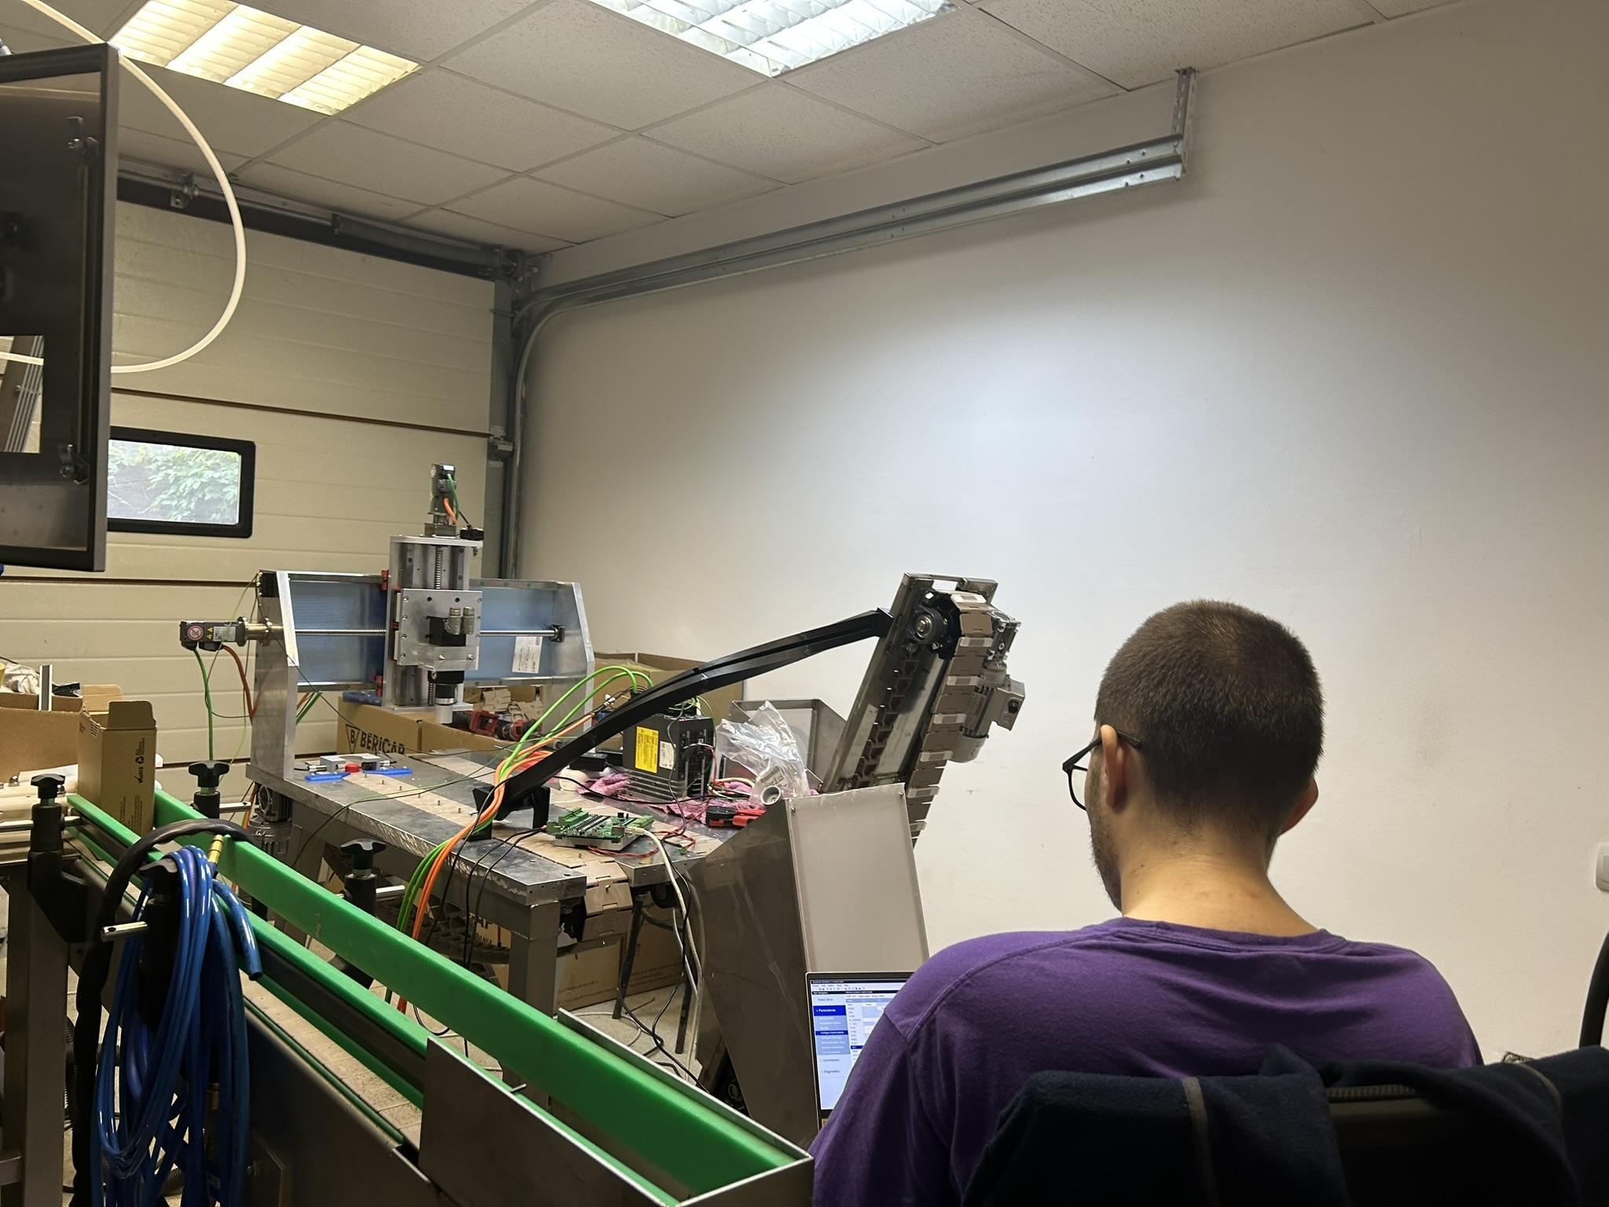
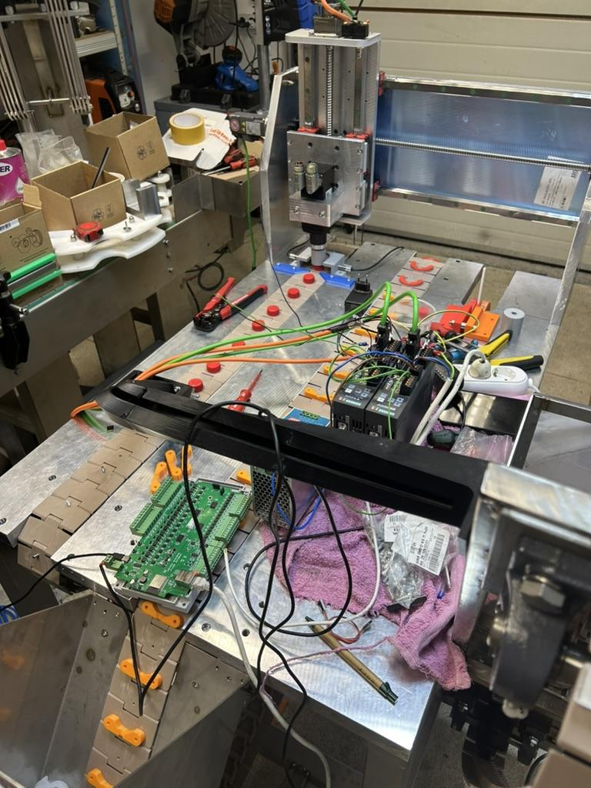
Proiectele Noastre
Automatizarea asamblarii pensulelor
2025 Copyright © by INPROTED– International Professionals for Technology and Education | All Rights Reserved

Slide 14
THANK YOU,
THE END
Code Sinaia 2025
2025 Copyright © by INPROTED– International Professionals for Technology and Education | All Rights Reserved

